Slide 1
LSC Learning Management System
Gardon, Jana marie g.
Heramia, johanna marisse c.
Tadeo, jose Lorenzo g.

Slide 2
Loyola Student Center (LSC)
Founded in the early 1980
Established in 1986
Tutorial and Review Facility
Solomon’s Ark Computer & Tutorial Services Center
High quality and affordable tutorial
Mission: To enhance the intellectual development of students
Vision: To become a center of educational excellence

Slide 3
Current System
Schedule was given manually
Cannot easily access summary of grades
Paper-based assignments and quizzes

Slide 4
LSC Learning Management System
Frontend:
Track student’s performance
Analyze performance
Notify student if there are task
Backend:
Manage courses, tasks and attendance
Create, delete and update courses and task

Slide 5
Objective
General Objectives:
To provide efficient way of learning
To provide faster tracking of student’s performance
To provide easier administration
Specific Objectives
To provide system and database
To provide faster administration of records
To announce updates faster
To provide easier access on student’s progress

Slide 6
Benefit
To student:
Usable anywhere
Manage performance easier
To parents:
Update about the student’s performance
To administrator:
Give tasks right away
Manage grades and attendance

Slide 7
Purpose
View schedule online
View summary of grades
View attendance online
Update information easily
View students progress

Slide 8
System Features and Functions
For Instructor:
Create course
Record attendance
Create and assign task
Give announcements
For Students:
Access review class
View attendance
Take tasks
See announcements
Keep track of grades

Slide 9
Programming Languages
HTML
CSS
PHP
JQuery
Bootstrap

Slide 10
Specific Software
Windows, Linux and Android
Yii2 advanced framework
Access on browser
MySQL for database
Integrate with the Enrollment System

Slide 11
Hardware Environment
At least 1.3 GHz processor or faster
128 MB RAM
80GB or above
At least 800 x 600 colors or above

Slide 12
Security
System will run inside the firewall
Different roles for admin, student and tutor (RBAC)
Password Encryption
Time limit of 1 hour
No printing and downloading of materials

Slide 13
Application System Modules
Quiz
Course
User

Slide 14
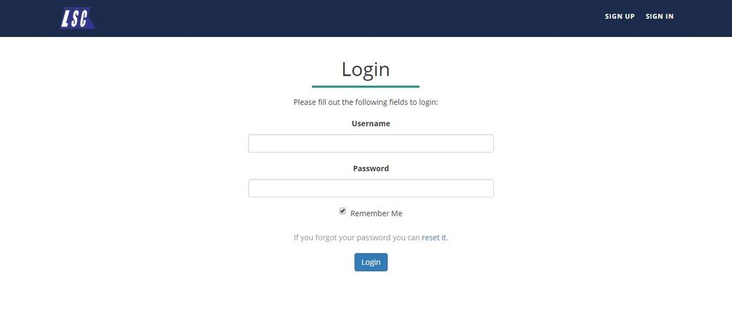
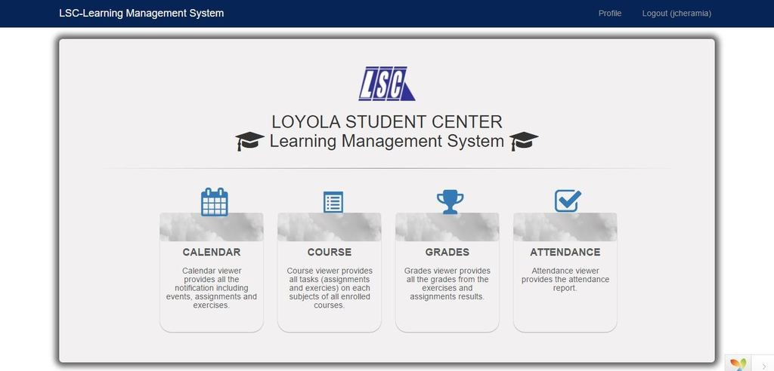
Frontend

Slide 15
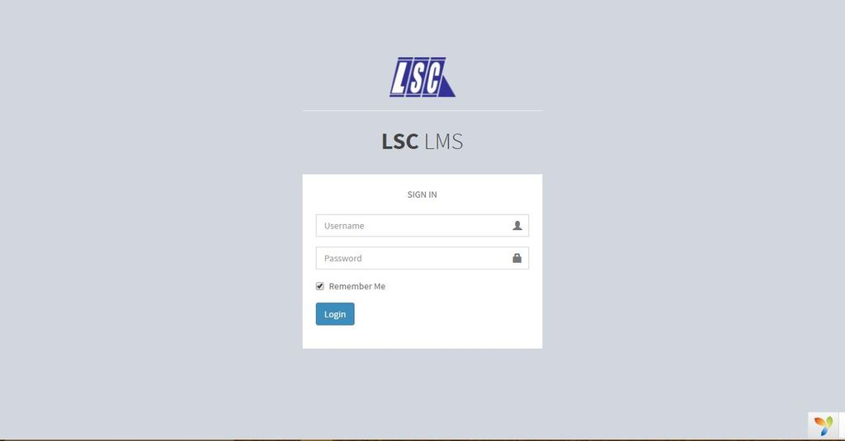
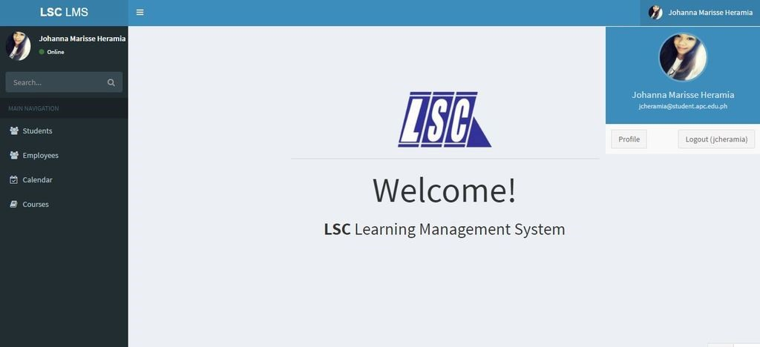
Backend

Slide 16
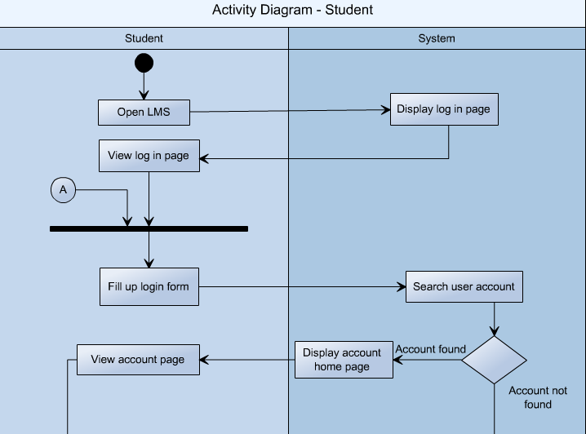
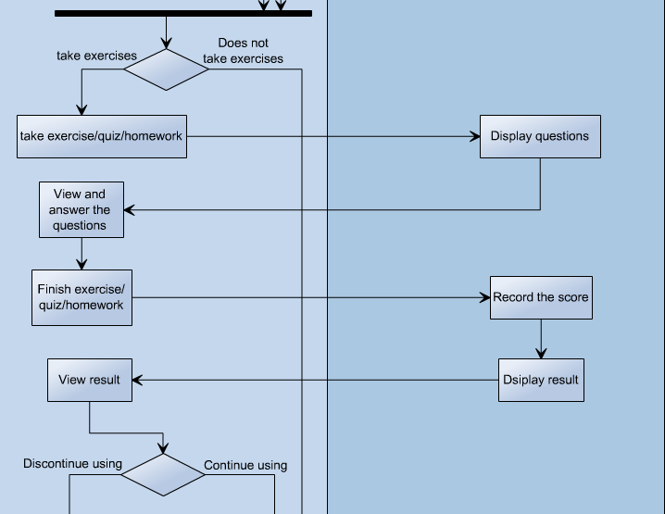
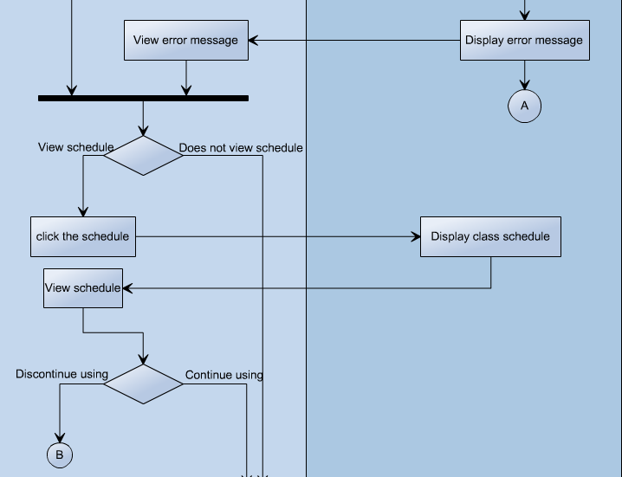
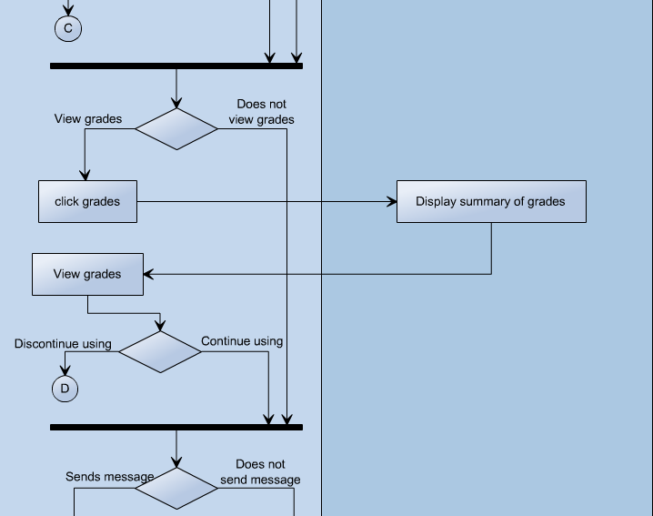

Slide 17
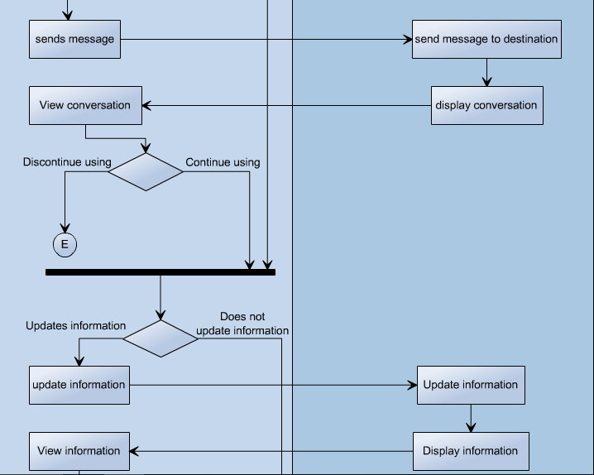
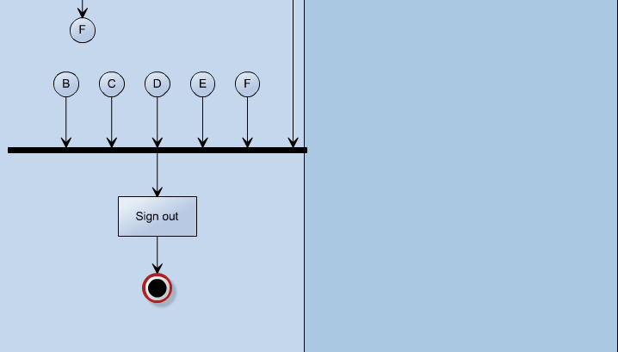

Slide 18
